Slide 1
Data Analysis Assessment of ABC Company
Presented by: Jonathan Wong

Slide 2
Background: Problem 2
“How can we understand which products are bought together?”
Possible Methods: Clustering, Collaborative Filtering, Search-Based Methods, Item-to-Item Collaborative Filtering
Best Method: Item-to-Item Collaborative Filtering

Slide 3



Background: Problem 2
Best Method: Item-to-Item Collaborative Filtering
“Why use Item-to-Item Collaborative Filtering?”
Efficient and scalable to massive data sets
Used by major
e-commerce giants
Calculates similarity between items in real time

Slide 4
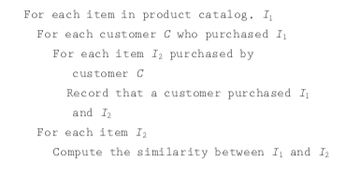
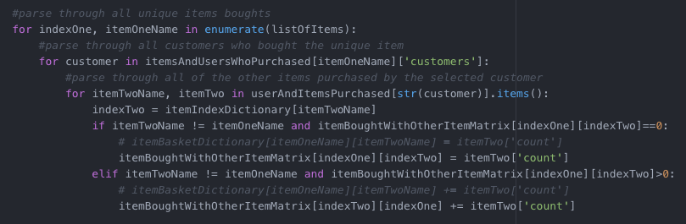
Data Analysis Method: Problem 2
The Item-to-Item Collaborative Algorithm was implemented in Python using numpy and pandas. Code can be found in itemBasket.py

Slide 5
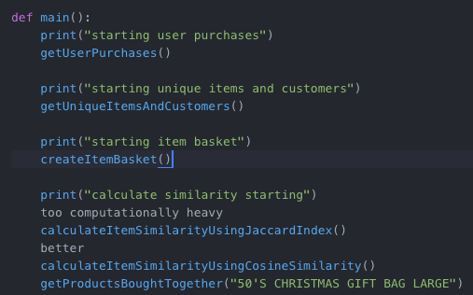
Data Analysis Method: Problem 2
The data was parsed through the excel file and items corresponding with customers and customers corresponding with items were found.
*very high level overview

Slide 6
Data Analysis Method: Problem 2
The similarity index value calculated was found using both the Jaccard Index and Cosine Similarity
of item vector of dimension M unique customers

Slide 7
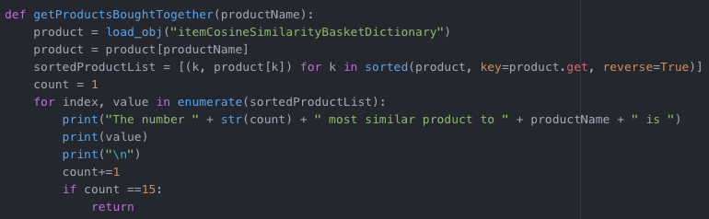
Insights: Problem 2
By creating a dictionary that stored each unique item and its corresponding similarity value of items bought in conjunction, I was able to create a function that returned most similar products that had the highest likelihood of being bought with the other items.

Slide 8
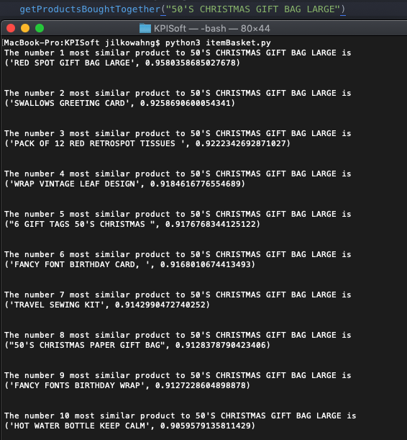
Insights: Problem 2
And wa la!
Just like magic, you can find similar products just by calling the function getProductsBoughtTogether!

Slide 9
Background: Problem 3
“How can we determine inventory levels for the next 12 weeks based on demand for our top 10 products?”
Best Method: Clean data, grab pertinent information for top 10 products, and visualize trends/model data over all time data

Slide 10

Data Analysis Method: Problem 3
Getting data ready to Analyze
1. Find most popular products by quantity
2. Find relevant information to analyze(month/year, quantity)
3. Rewrite the relevant information for just the popular products into excel to analyze
*very high level overview
code in inventoryLevel.py

Slide 11
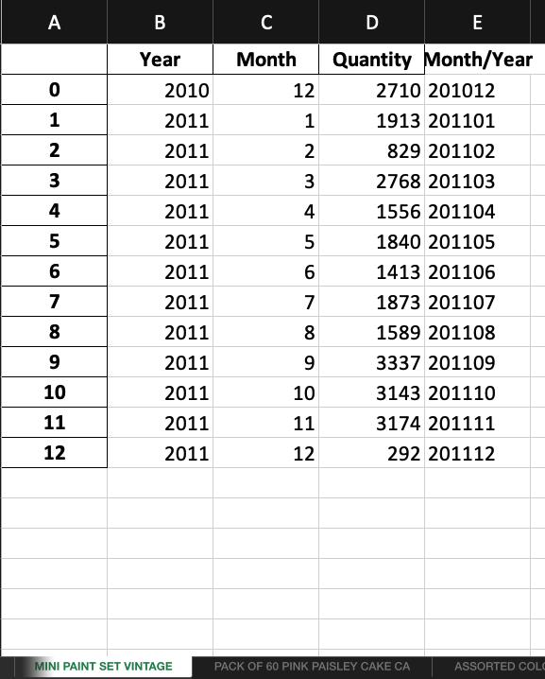
Insights: Problem 3
Now that quantity sold data for each month for each top 10 selling product has been input into excel
We can graph the quantity sold over time to see seasonality and different trends of demand.

Slide 12
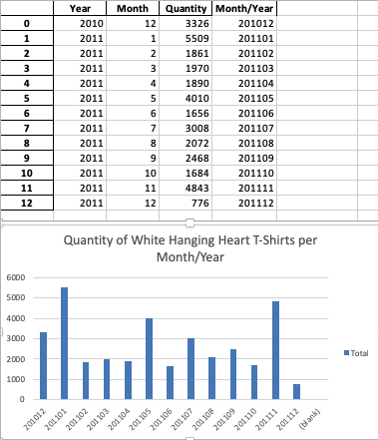
Insights: Problem 3
Here’s one example of trend analysis for the popular item: White Hanging T-Shirts
It’s pretty clear from the visualized data that there is a cyclical spike around every 4 months
Using the data found here, you could easily average the quantity in a given time frame of 12 weeks and then use the amount found to stock a closer amount of inventory to the actual amount bought.

Slide 13
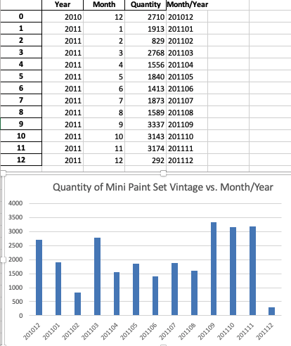
Insights: Problem 3
Here’s another example of trend analysis for the item: Mini Paint Set Vintage
The pattern here is a lot harder to see with just Month/Year. Extra granularity of Week/Month/Year would expose trends more easily.
Once again, averaging the quantity over the corresponding time span in the historical data could better predict necessary inventories.

Slide 14

Insights: Problem 3
All trends and quantities are different between products
Inventory for the future all depends on what time frame and product you need!

Slide 15
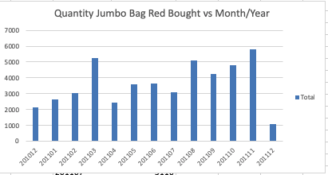
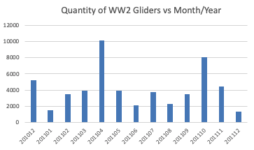
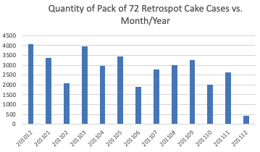
Insights: Problem 3
All trends and quantities are different between products
Product Inventory trends
should be analyzed on a
case-to-case basis.
Use average quantities over time to predict future quantities

